Slide 1
Christine Kuglin JD, LLM, CPA, CFE
Director - Truth in Accounting
Daniels College of Business
School of Accountancy
University of Denver
Christine.Kuglin@du.edu
Amy Cardillo, CPA
Senior Leturer of Accounting
Metropolitan State University of Denver
/TruthinAccounting
@truthinacct
@truthinacct
Truth in Accounting

Slide 2
Truth in Accounting
examines the data produced by governments
Financial States of the States, Cities and Federal Government
Customized Reports
Transparency Report
Education articles
Data-Z.org
Data Modernization in Governmental Reporting
Financial Data Transparency Act Dec. 2022

Slide 3
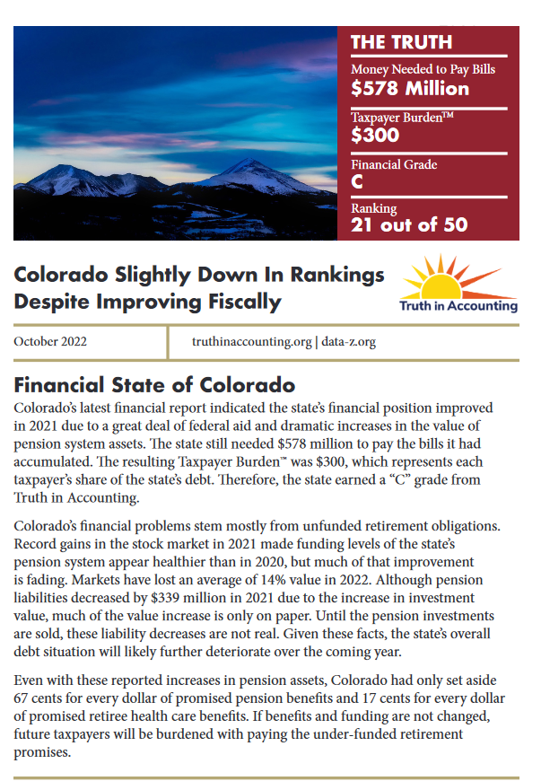
https://www.truthinaccounting.org/

Slide 4
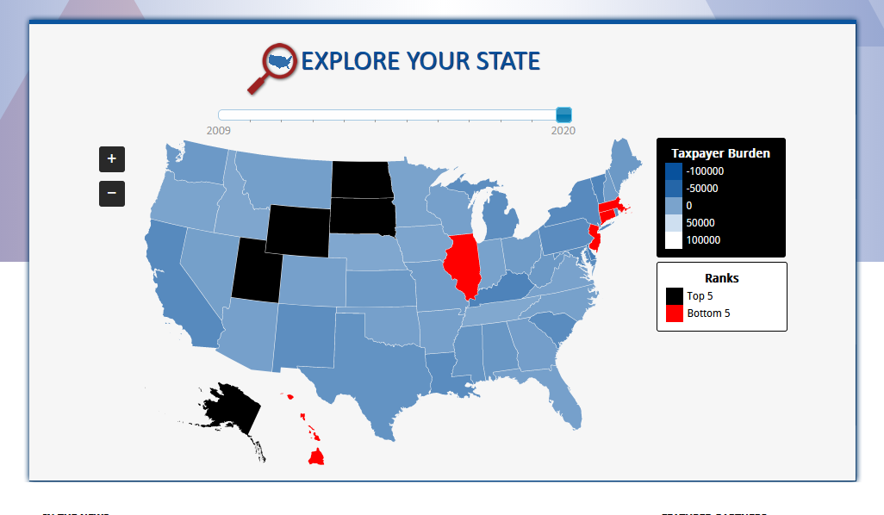
Data-Z.org

Slide 5
Charts
Federal Charts: Charting Federal Assets over the last 10 years
You Try It!
Plot governmental revenue vs. governmental expenditures from 2012 – 2022. Where does the primary source data come from?
Plot the US Civilian labor force participation rate last 10 years. What two years had the highest civilian labor force participation rates?

Slide 6
Charts
State Charts: State and local Tax Revenue per Capital last 10 years for Florida, Texas, and California:
You Try It!
Plot Alaska, Vermont, and Wyoming (most recent 10 years). Which state has the highest state and local tax revenue per capita?
Male vs. Female Employment (most recent 10 years) for California vs. Texas. Plot each (hint: You must do male and female separately as, with the free version, you are unable to plot multiple data series). Which state has the higher female employment? Male employment?
Compare your home state with a similar sized state.

Slide 7
Charts
State Charts, continued: Florida and New York: Black vs. Hispanic. vs. White employment
You Try It!
Compare your state with a similar sized state
Compare the quality-of-life index between Hawaii and New Jersey. What do you notice?

Slide 8
Charts
Pensions: I found a recent journal article about the pension burden in the Annual Review of Financial Economics (online publication date May 17, 2023, journal pub Nov 2023): Trends in State and Local Pension Funds.
https://www.annualreviews.org/doi/abs/10.1146/annurev-financial-110921-022054
I looked up my Home state: Colorado.
You Try It!
Compare Florida, Texas, and California. Which state has the highest unfunded pension benefits?
Compare with your state

Slide 9
Lesson Plan (Intro to Governmental Accounting)
Here is a sample lesson plan I put together using Data Z:
1) Define the difference between the US deficit and the US debt
2) What does a “balanced budget” mean?
Activities:
1) Balanced Budget
What are the federal governmental expenditures?
What are the sources of governmental revenue?
If your job was to propose a balanced budget, what would you propose?
2) US National debt
What is the US national debt?
How much does the US have in unfunded liabilities?
What steps do you think should be taken to reign in our national debt?
What hurdles do you see for creating a balanced budget and reigning in national debt? How would you overcome those hurdles?

Slide 10
Create a Sample Lesson Plan
Brainstorm lesson plans
We will collect and forward to everyone for classroom use

Slide 11
XBRL is a machine readable, standards-based way to communicate and exchange business information between business systems.

Slide 12
Taxonomy

Slide 13
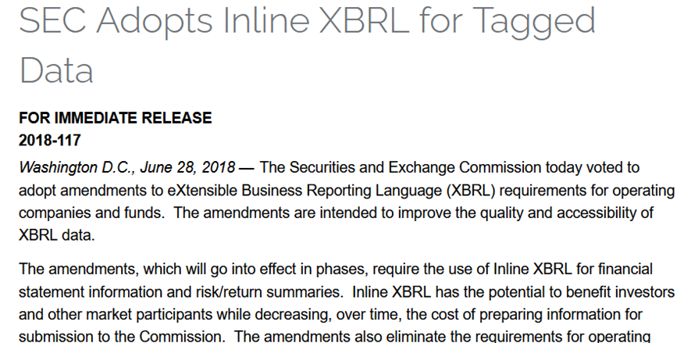
New Generation - Inline

Slide 14
Governments Using XBRL https://app.iriscarbon.com/Home/DashBoard/#/home https://app.idaciti.com/login

Slide 15
Questions?
www.truthinaccounting.org
www.data-z.org
Christine.Kuglin@du.edu
Amy Cardillo
/TruthinAccounting
@truthinacct
@truthinacct
Truth in Accounting

